Slide 1
Design and drawing for production
Unit 7 – Intro to Dimensioning
Section 1 – Intro to Dimensioning

Slide 2
The big idea
Dimensioning helps communicate object size relative to scale
Without dimensioning nothing could be properly communicated to create
Dimensioning allows designers and architects to communicate on criteria and specifications

Slide 3
Dimensioning
A dimension is for size and position (the design/modeled shape)
A dimension is a numerical value expressed in appropriate units of measurement and used to define the size, location, orientation, form or other geometric characteristics of a part
A method of communication to machinists in production
Linear
Aligned
Angular
Radius/Diameter
Reference

Slide 4
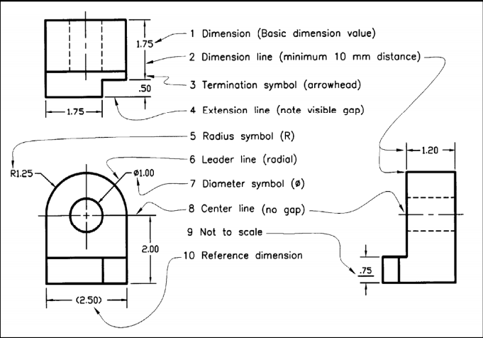

Slide 5
UNITS OF MEASURE
Decimal inches (preferred), fractional inches, feet and fractional inches
SI or metric – millimeter (mm)

